Slide 1

DigitalHealthEurope
Support to a Digital Health and Care Innovation initiative in the context of Digital Single Market strategy
Lutz Kubitschke, empirica Technology Research , Bonn, Germany

Slide 2











DigitalHealthEurope (DHE) in a nutshell
Title: Support to a Digital Health and Care Innovation initiative in the context of Digital Single Market strategy
Duration: Jan ´19 – Dec ´20 (2 years)
Coordinator: empirica, Germany
Instrument: HORIZON 2020
Type: Coordination & Support Action
Grant Agreement Number: 826353
Acronym: DigitalHealthEurope
Budget: €3,999,993.75
Carried out by 17 partners supported by a Board of 50+ Associated Experts
Partners‘ members have >1,100 members, outreach to >20,000 organisations

Slide 3
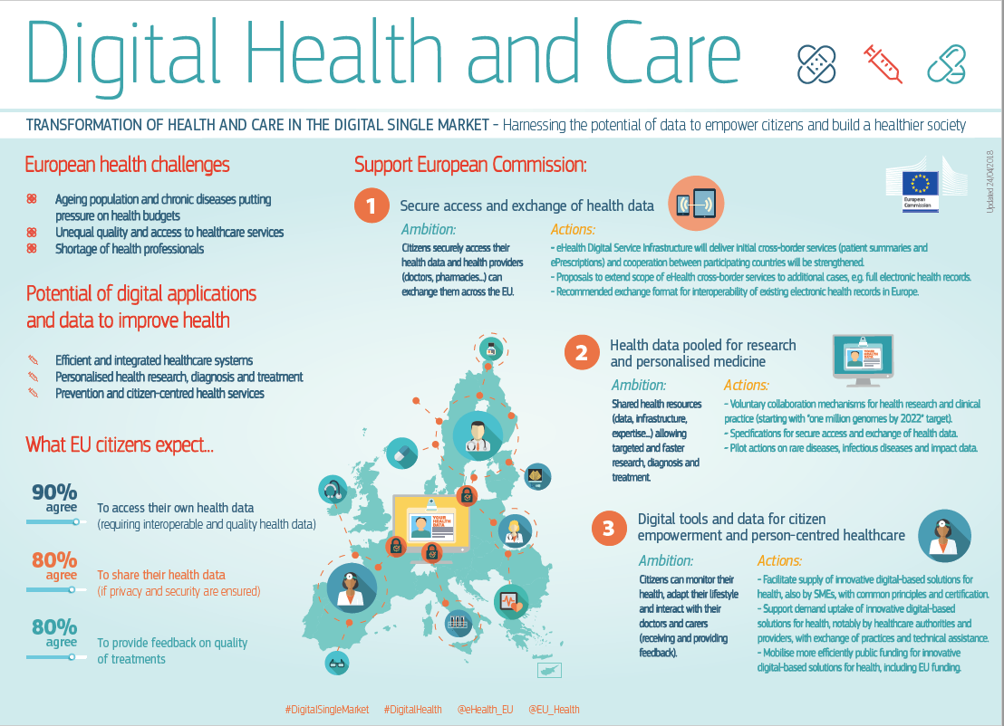
Background
Source: https://ec.europa.eu/digital-single-market/en/news/infographic-digital-health-and-care-eu
Notes:
2018 Communication on enabling digital transformation of health and care in the Digital Single Market (DTHC) priorities:
empowering citizens
building a healthier society
Multi-pronged DHE approach:
Support to large scale deployment of digital solutions
Support to collaboration in multi-stakeholder communities
Facilitated by analyses of cross-cutting themes & mutual flow of information & knowledge gained
All feeds into common VISION development work strand yielding tangible outputs (executable recommendations)

Slide 4
Operational objectives
Provide centralised, integrated and continued support to scaling up and deploying digital solutions for chronic diseases and integrated, person-centred care
  highly impactful and replicable
  may cover public and non-public initiatives
Analyse, elaborate and promote enabling factors and building blocks towards reference frameworks that enable scaling up and deployment of the digital solutions
  guidelines
  funding advice
  methodologies and tools such as for impact assessment
Facilitate the forming of collaboration platforms on key aspects of the digital transformation of health and care priorities of the Digital Single Market
  co-ordinating platform participants to analyse key challenges and solutions
  elaborate common strategic agendas and commitments
Foster the policy vision with respect to the EU’s co-ordination and support on Digital Transformation for Health and Care (DTHC) topics beyond 2020
  analysis of the scaling up and collaboration platform work
  collection of feedback from all stakeholders,
  formulation of concrete recommendations – policy, legislative, regulatory, Multiannual Financial Framework (MFF) post 2020

Slide 5
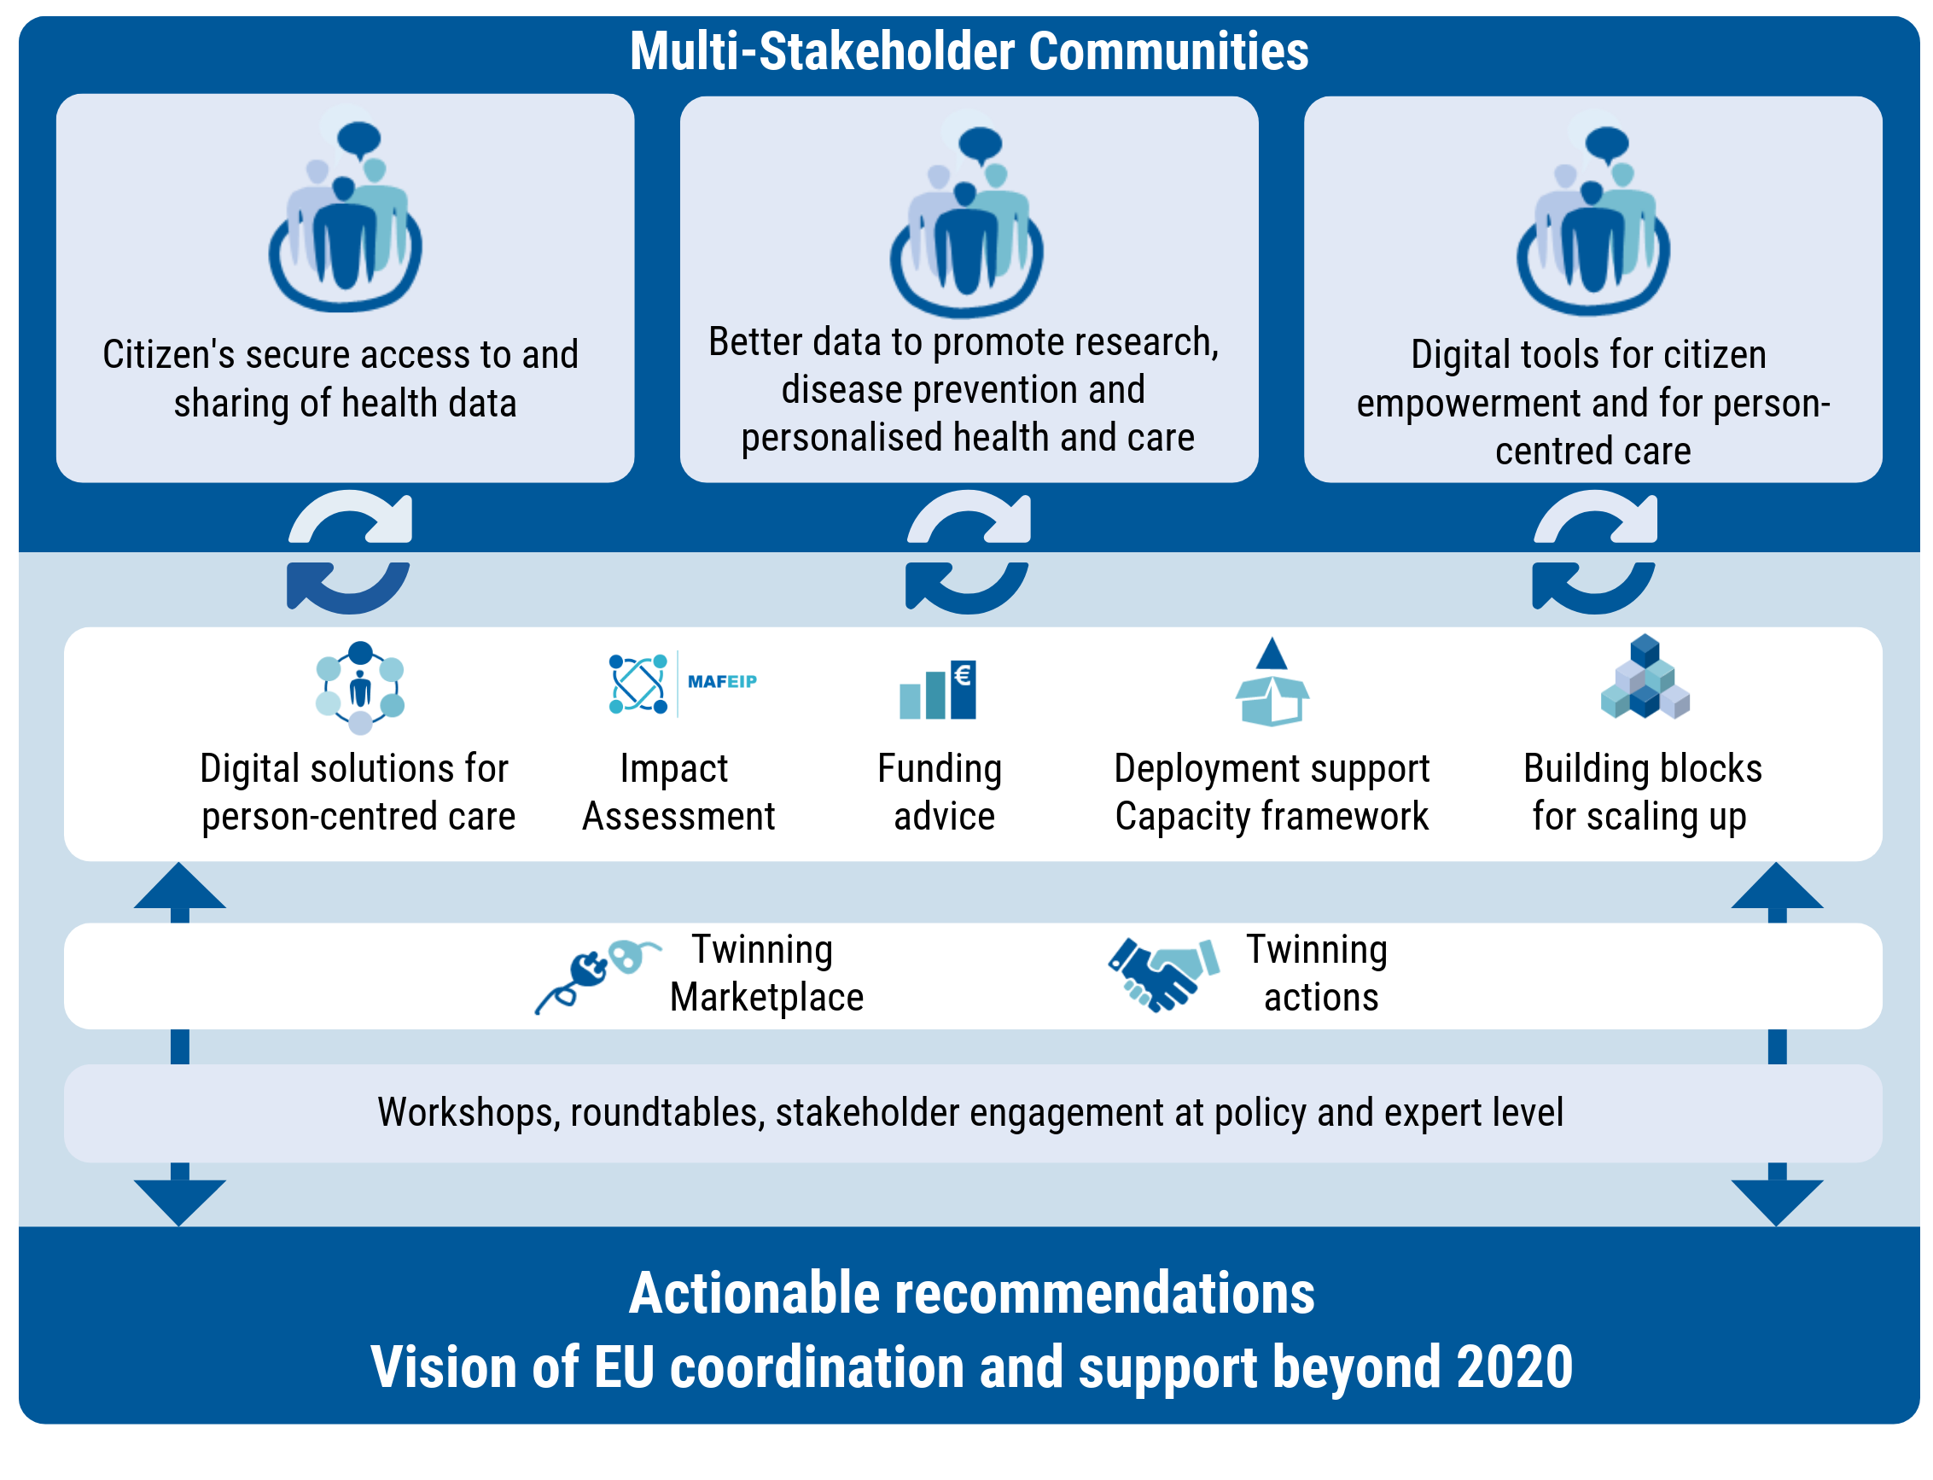
Overview of key activities

Slide 6



The twinning scheme (Lead: empirica)
Builds upon experiences gained in the ScaleAHA¹ study and the WE4AHA² project
Provides a mechanism for scaling up innovative digital solutions
Includes provision of funding by DigitalHealthEurope to enable the transfer of innovative solutions from one European region or country to another
1st call for applications closed, 2nd call planned for December 2019
~€ 1 Million in funding for Twinnings on innovative digital solutions in 2019-2020
Twinning
Preparation
Twinning
Call
Twinning
Evaluation
Twinning
Execution
Twinning
Results
1 http://www.scale-aha.eu/home.html
2 https://cordis.europa.eu/project/rcn/211372/en

Slide 7
Twinning scope
Knowledge Exchange
Focus on exchange of know how, capacity building & training (e.g. staff skills)
Maximal cost for one twinning: € 5,000
Focus on adaption of mature innovation to local conditions ( e.g. translation into local language)
Adaptation
Maximal cost for one twinning: € 9,500
Partial Adoption
Focus on implementing elements of the innovation using locally available infrastructure (e.g. software, strategy, …)
Maximal cost for one twinning: € 17,000
Full Adoption /Acquisition
Focus on implementing of the innovation in its full scope using locally available infrastructure (fully adopter managed)
Maximal cost for one twinning: € 43,000

Slide 8
Twinning activities
Contractually agreed activities & deliverables
Transfer of digital innovation & know-how to at least one Twinning Adopter region from another region or organisation (Twinning Originator).
Twinning Originator and Twinning Adopter(s) must be from different countries
Further analytical support instrument provided by DHE (Leads: Funka, IFIC)

Slide 9

Citizens’ secure access to & sharing of their data across borders (Lead: SPMS, Portugal)
Multi-stakeholder Community I
Collaboration on citizens’ secure access to and management of their own health data; sharing of data across borders
  Common agenda on how to advance digital health literacy
  New ways for sharing data across borders
  Efforts towards the adoption of the European Electronic Health Record exchange format
  European guidelines for citizen-controlled data governance

Slide 10

Better data to advance research, disease prevention and personalised health & care (Lead: EuroRec)
Multi-stakeholder Community II
Collaboration on data infrastructure; better data, personalised medicine
  Challenges for regional, national, EU infrastructures handling personal and/or anonymous health data
  Criteria to ensure cross-border access to genomic data
  Business drivers for scaling up the reuse of health data
  Business models for Real World Evidence, safeguards to ensure public trust

Slide 11

Citizen empowerment, interaction with health care provider (Lead: European Patients‘ Forum)
  Multi-stakeholder Community III
  Collaboration on scaling up of digital solutions for citizen empowerment and for person-centred care in Europe
  Analysis of the experiences of European initiatives
  Guides for successful implementation of digital solutions for citizen-health & care professionals interaction and active cooperation
  Empowerment roadmap for healthcare providers to better engage with patients and caregivers
  Indicators to measure Patient Reported Outcomes (PRO)

Slide 12
Key outcomes
End of 2019:
  White paper on better utilisation of data infrastructures to support secondary uses of health data (D5.1)
End of 2020:
  White paper on better citizen access and control of data (D4.1)
  Recommendations and guidelines on citizen-controlled data governance models and data donation campaigns for health (D4.2)
  Recommendations for facilitating adoption of interoperability standards (D4.3)
  Prioritised infrastructure capabilities and enablers to ensure EU-wide cross-border access and exchange of genomic and other health data (D5.2)
  Guide for scaling up digital solutions for citizen-HCP interaction (D6.1)
  White paper on boosting active cooperation between patients and health and care providers (D6.2)

Slide 13
Vision of EU coordination & support
(Lead: empirica)
Actionable strategic vision for EU policy on DTHC beyond 2020, incl. mobilisation of EU instruments
Multi-stakeholder roundtable discussions on selected horizontal issues of high relevance to the DSM strategy:
  Health data privacy and GDPR, ePrivacy: How to balance societal good and personal protection?
  Health data standards and interoperability: How to overcome the very poor extent of standards adoption?
  Value-based care: How to grow evidence on innovative models that priorities and reward delivering health value?
Recommendations for future EU support on Digital Transformation of Health and Care

Slide 14
Thank you for your attention!
info@digitalhealtheurope.eu
https://digitalhealtheurope.eu/

Slide 15





Evidence-based Guidance to Scale-up Integrated Care in Europe
www.vigour-integratedcare.eu
@VIGOUR_EU
VIGOUR Project

